Slide 1
Fiscal Impact Requests
Joint Committee on Legislative Research
Oversight Division

Slide 2
Response Rate for Senate Bill 676
Introduced: 3.5%
TAFP: 5%
4 Out of 115 Assessors
6 Out of 115 Assessors
Responded to the Introduced version of Senate Bill 676.
Responded to the Truly Agreed To and Finally Passed Senate Bill 676.

Slide 3
About Us
Oversight Division
We prepare over 2,500 fiscal notes during a legislative session.
The Oversight Division has two primary duties:
the preparation of fiscal notes
the performance of program evaluations and sunset reviews.

Slide 4
What is a Fiscal Note?
A Fiscal Note is a:
Statutorily required;
Unbiased;
Estimate of direct impact;
Available to the public.

Slide 7
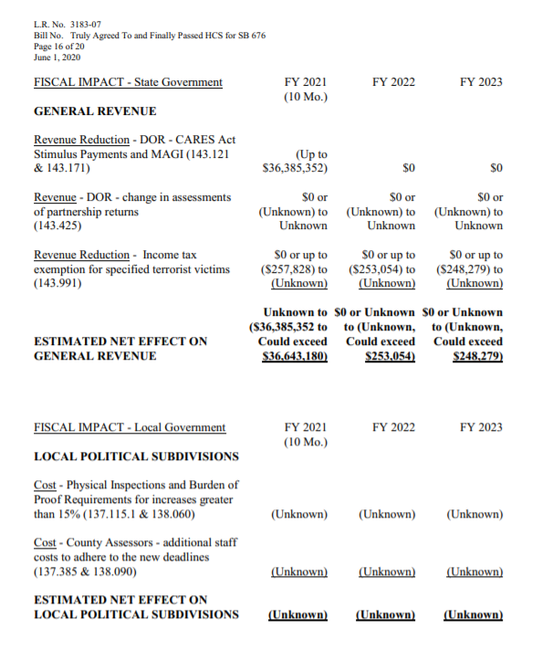
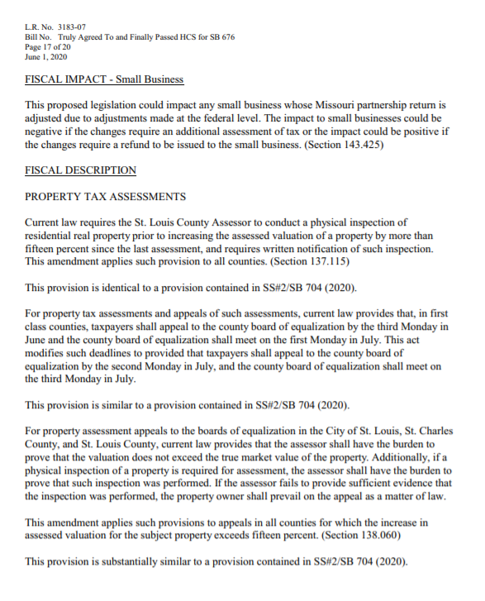

Slide 8
Fiscal Notes are an important part of the legislative process. Fiscal Notes are used:
By Legislators during floor debate and hearings;
By Agencies and Appropriation staff during the budget process;
By news entities when reporting on proposed legislation;
By the Public.

Slide 9
Fiscal Notes are not:
Estimates of indirect or induced effects;
Budget requests or appropriation amounts;
Opinions on the merits of proposed policies;
Error proof or unalterable.

Slide 10
Fiscal Note Overview
Fiscal Note Request
Fiscal Impact Request
Missouri Legislature
Oversight Division
Local Government
Fiscal Impact Statement
Fiscal Note

Slide 11
What We Do
Collect Information
Compile and Analyze
We review over 3,500 pieces of legislation and identify impacted entities.
We attempt to gather information from over 2,800 local political subdivisions and state agencies.
We collect data using internal and external databases and resources.
We review and compile all the responses into the fiscal note that accompanies the proposed legislation.
We contact responding entities if we have additional questions or conflicting information.
We conduct independent analysis of the potential impact using the data collected. We extrapolate and aggregate information to assess the overall impact.

Slide 12
Response Time
Most due dates are tentative and can change based on where the bill is at in the legislative process.
1 Week
2 Weeks
Same Day
Committee Substitutes
Floor Substitutes
Introduced Bills
Truly Agreed To and Finally Passed
Amendments
Conference Committee Substitutes

Slide 13
Responses that work
County C assumes this proposal will cost $95,000 annually for two added field appraisers to complete increases over 15% and provide written notification.
County B assumes additional staff may cost between $2,000 and $5,000 to complete assessments at an earlier date.
County A would realize a savings of $1,600 if this proposed legislation were to pass.

Slide 14
Example of a Good Response
Identified the section number.
Identified the historical experience.
Identified the key assumption.
Identified the impact from specific amendments.

Slide 15
Another Good Response
Demonstrated the impact using an example.
Discussed limitations of the estimate.
Identified the language driving the change.
Described the key assumption.

Slide 16
Official Response Form: Local Worksheet
Our local government estimates the fiscal impact of the above-referenced bill for fiscal years 2022, 2023 and 2024 to be as follows:
(Reminder: 2022 will likely be a portion of a fiscal year, depending on effective date of bill)
Revenue Increases: (explain amount per fiscal year and source or reason for increase)
Section 102.600 - We think this proposal will generate up to $200,000 for our county on an annual basis.
Revenue Losses: (explain why revenue losses would be expected and amount per fiscal year)
Section 102.600 - Should this proposal be enacted, the county will lose $5,000 annually in fee revenue.
Cost Increases: (explain what type of costs will be incurred, amount per fiscal year and reason)
Section 102.600 - We will need to hire another computer programmer to meet the needs of this proposal. Personal service cost at $60,000; Benefits at $15,000 for a total of $75,000 per year.
Section 103.400 – Postage cost of $50,000 on an annual basis.
Cost Savings: (explain amount per fiscal year, reason for savings and area where savings will occur)
Section 102.600 - This proposal will save our county $100,000 per year in legal expenses.

Slide 17
Elements of A Good Response
Identify key assumptions
Identify the impacts by section number
Itemize each impact
Include historical trends or experiences
Quantify the impact, use examples
Provide supporting data

Slide 18
Other Types of Responses
Comment Memo
Technical Memo
The Comment Memo can be used to express concerns or suggest changes related to the proposed legislation. The comment memo will be forwarded to the drafter of the legislation.
A Technical Memo can be used to identify technical errors in the drafting of the proposed legislation such as bad sectional references or conflicting sections. Technical Memos are also forwarded to the drafter.
Moving responsibility to another entity
Unfunded Mandate
Improve wording to eliminate confusion
Misspellings
Wrong effective year
Incorrect sectional reference

Slide 19
Examples of Comment and Technical Memos
“Missouri is a non-disclosure state on sales. Most assessment offices do not have the capability to perform paired sales analysis as fee appraisers do because of no sales reported.”
“This is an unfunded mandate and likely unconstitutional.”
“Consider adding Section 288.132, RSMo instead of 288.131, which does not exist.”
“This change is long over due.”
“Subsection 6 is new language and should be underlined.”
Note: Comment and Technical Memos should be separate from the fiscal impact statement.

Slide 20
How often Are Fiscal Notes needed?
Fiscal Notes are needed at various stages of the legislative process:
Before a bill is heard in a hearing
When a bill is reported out of committee
When a bill is Perfected
When a bill is amended
When a bill is Truly Agreed To and Finally Passed

Slide 21
Welcome to MOLIS
Missouri Legislative Information System
Register for an Account
Access Requests
Track Responses and Due Dates
Submit Responses
Access Forms

Slide 22
Register for an Account
Missouri Legislative Information System (MOLIS)
If you do not already have access to the system send an email to helpdesk@lr.mo.gov
You will then receive an email link to register
Once you are registered you will start receiving request for responses

Slide 23
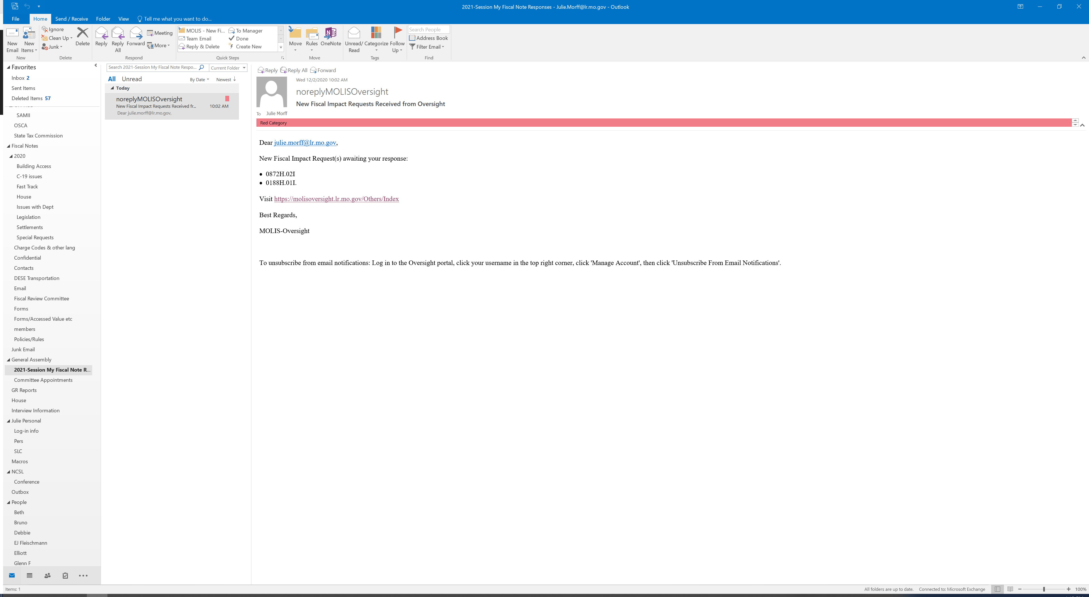
Once you are registered you will receive an email similar to the below
Click on the link provided and it will take you to the portal
Link
Tip: Save this link on your favorites tool bar
Note- you will only receive an email at 10:00 a.m. and 4:00 p.m. – however files will be added periodically throughout the day if you want to check back or refresh the page.

Slide 24
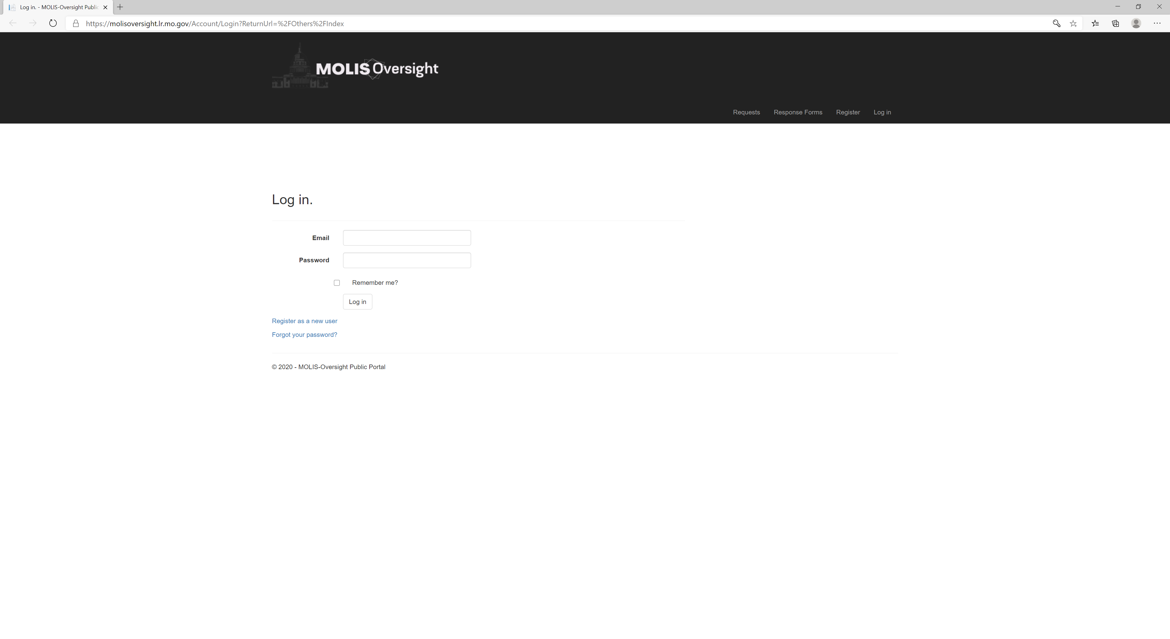
The link will bring you to this portal

Slide 25
You should now be able to view your legislation
If you click on options you will be able to view the legislation or create a response.

Slide 26
View Legislation - Cover Sheet
Legislative Research (LR) Number
Tentative Due Date
Bill Number
Sponsor of the Bill
Agencies Assigned
Analyst Contact Information

Slide 27
Creating a Response
Here you will select the impact status.
If the legislation has NO impact on your organization then click No, there is no impact and Save/Submit To Oversight
If the legislation has an impact click Yes, there is an impact then complete the pertinent forms (see next slide for form information)
Upload forms and any supporting documents in this page
You can add notes for the Oversight analyst.
You can Save the Response and come back later to finish or
Save and submit a response if its complete

Slide 29
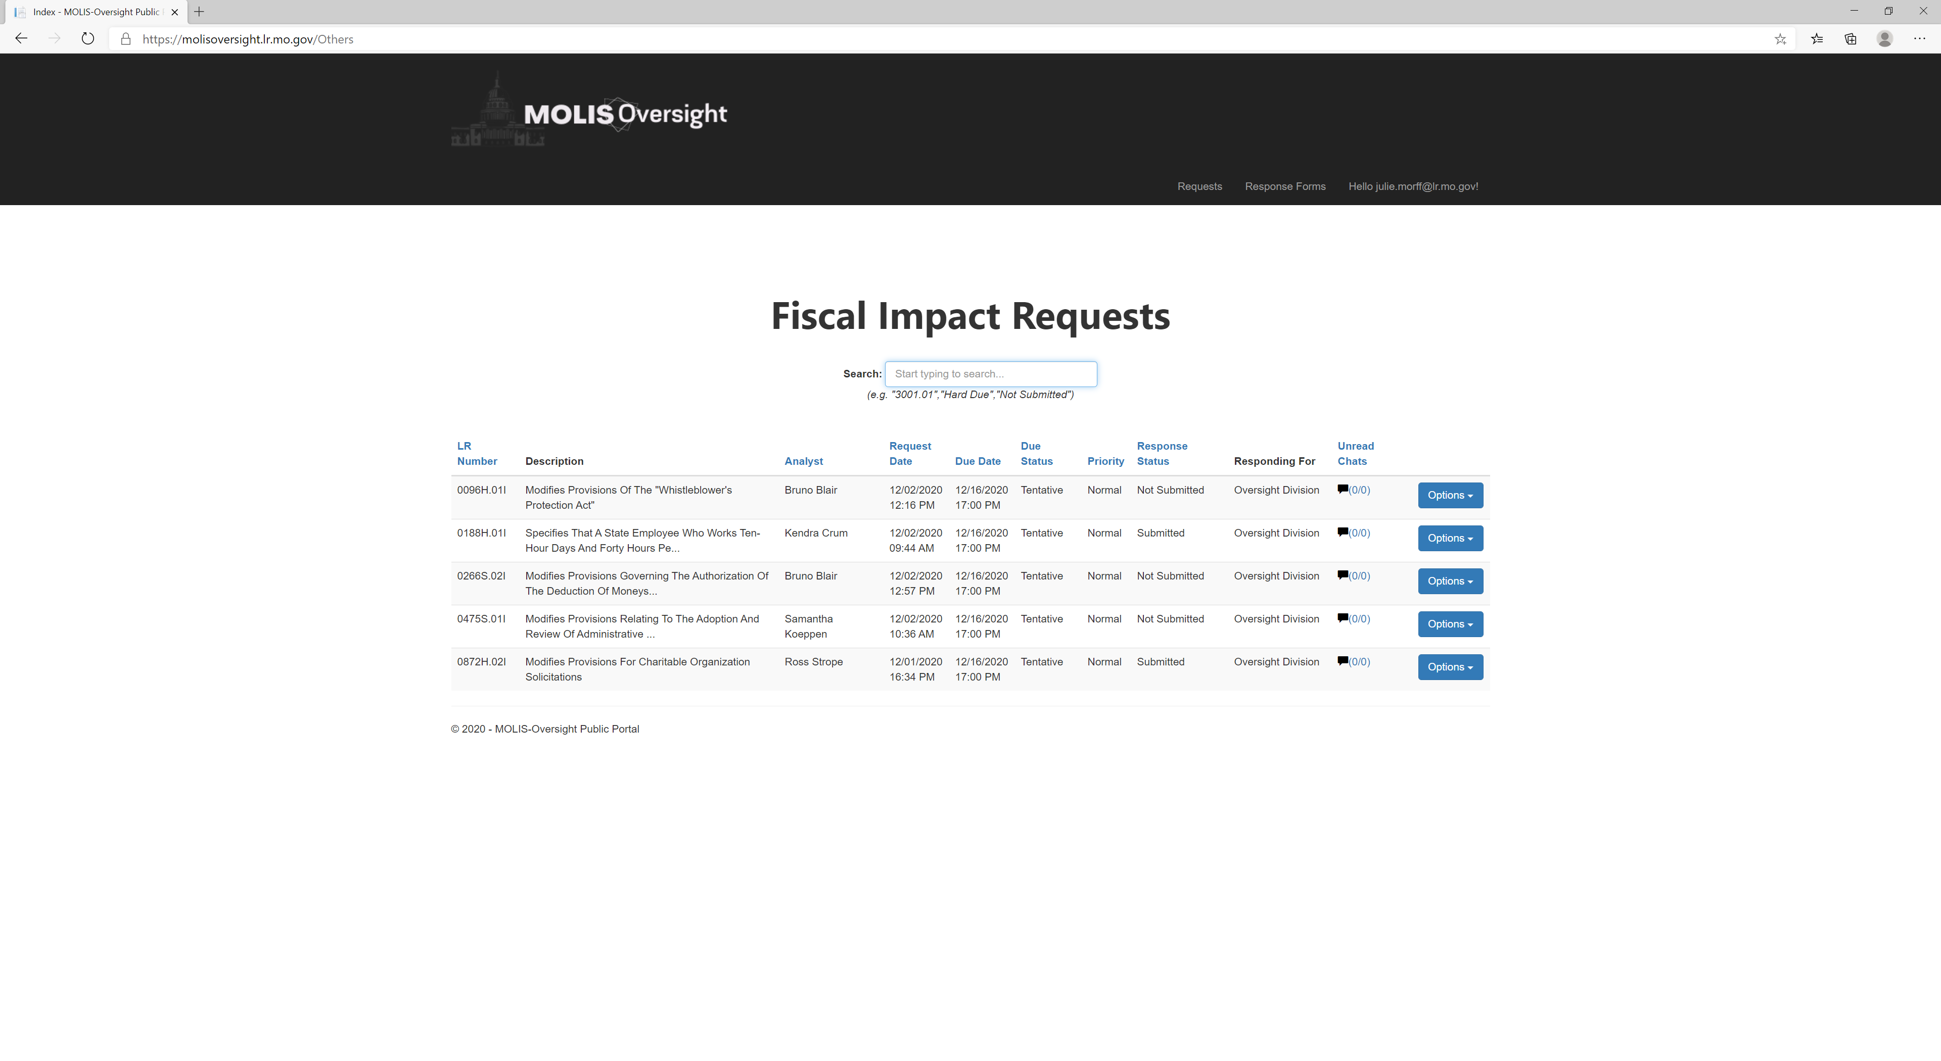
If you click on the Requests tab on the top tool bar –all of your legislation will appear
Easily know if you have responded – you can also click on Response status and it will sort for you

Slide 30
Chat Feature
Click on the numbers in the Unread Chats column to read a chat from the Oversight analyst or send a message to the Oversight analyst.

Slide 31
Bills that Received a Hearing
HB 1914 (2020) – 4.3% Response Rate
Solar Energy Projects
HB 1907 (2020) – 3.5% Response Rate
Transportation or Storage of Liquid and Gaseous products
HB 2454 (2020) – 0.8% Response Rate
Wind Energy Projects
HB 2232 (2020) – 1.7% Response Rate
Commercial Property Occupancy
SB 550 (2020) – 0.8% Response Rate
Abated Property
SB 983 (2020) – 0% Response Rate
Agricultural Land Productive Values

Slide 32
Important Dates
September
December
January
May
June
Registration
Pre-File
Session Begins
Session Ends
TAFP Notes
Registration for an account on MOLIS Oversight Portal begins.
Bills are pre-filed beginning December 1st.
Session begins Wednesday January 6th.
Sessions ends Friday May 14th.
Responses to TAFP bills are due by June 15th.

Slide 33
Team Contacts

Slide 34
Resources
Missouri Senate
www.senate.mo.gov
Missouri House of Representatives
www.house.mo.gov
Oversight Division
www.legislativeoversight.mo.gov
Missouri Revised Statutes
www.revisor.mo.gov

Slide 35
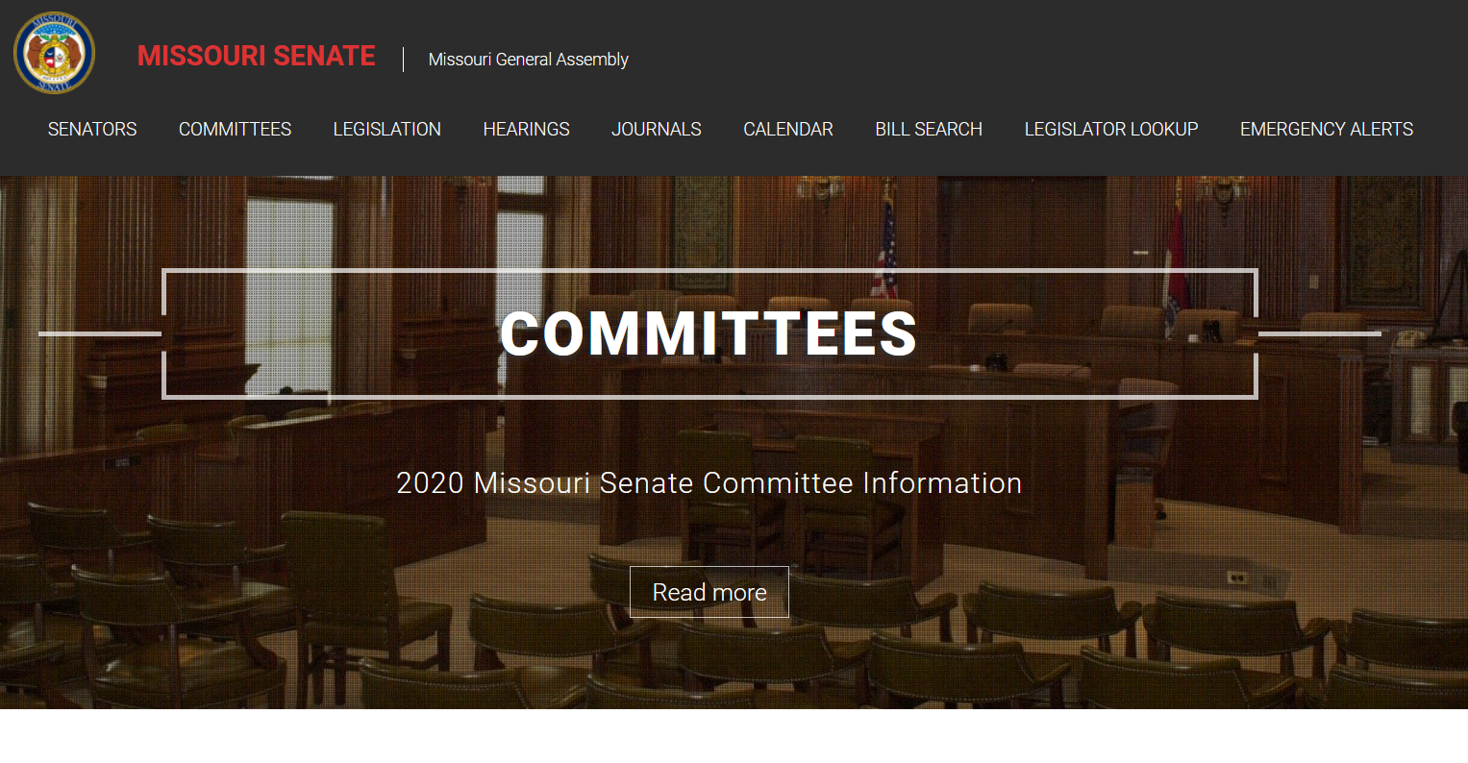

Slide 36
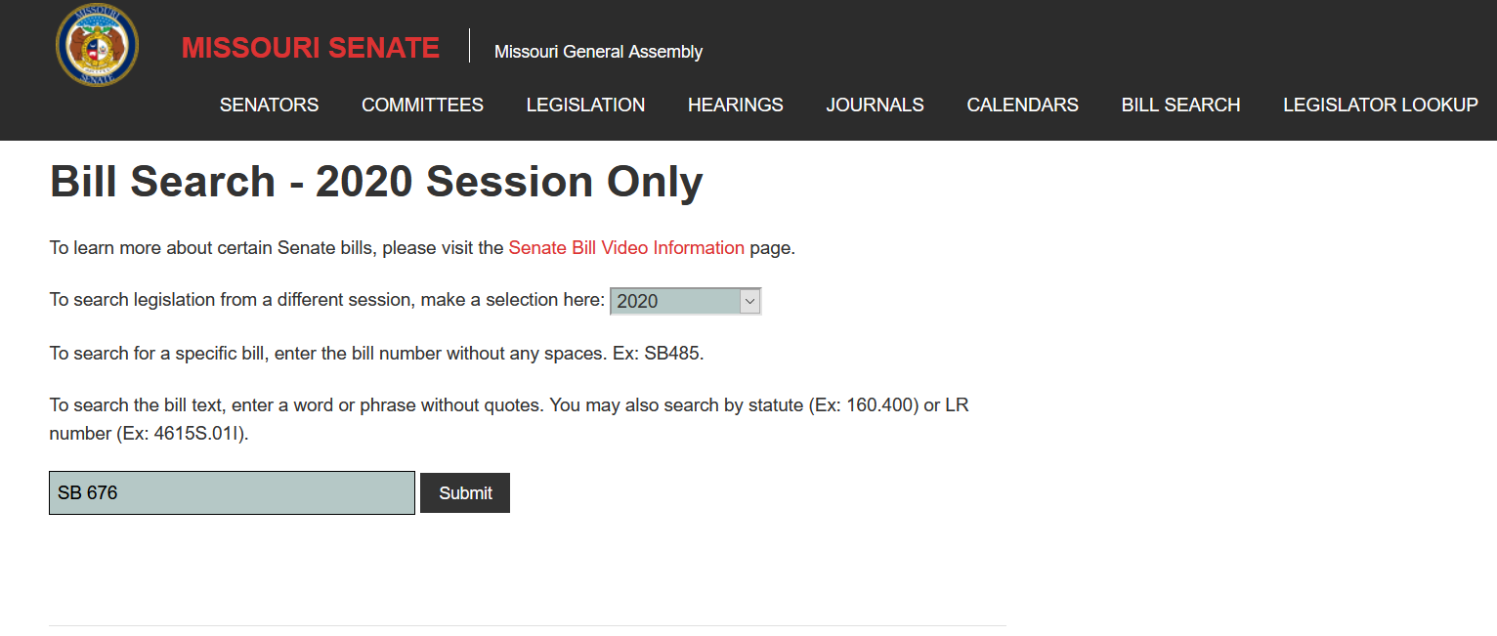

Slide 37
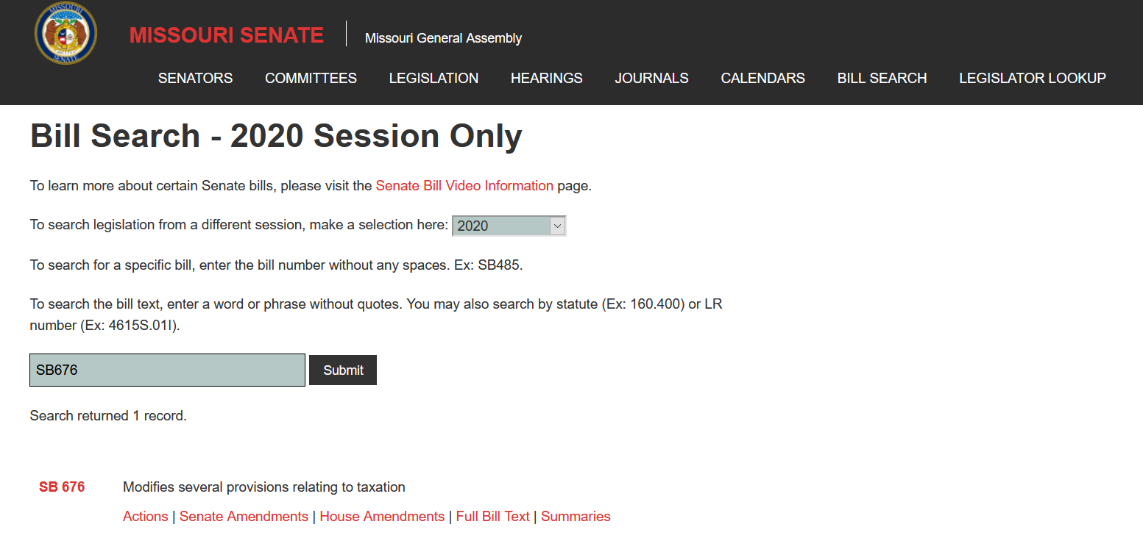
Click Here

Slide 38
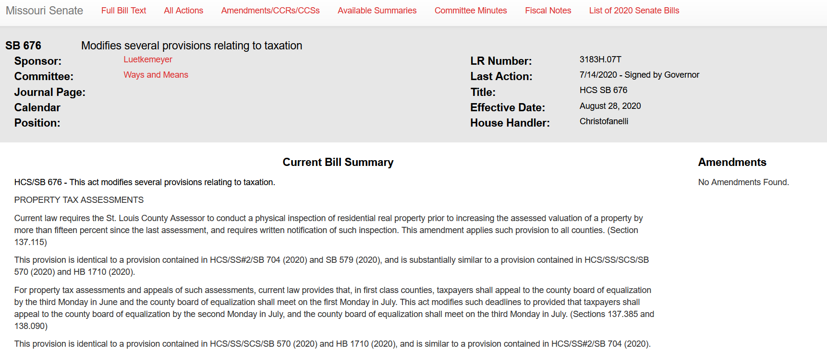
Click Here

Slide 39
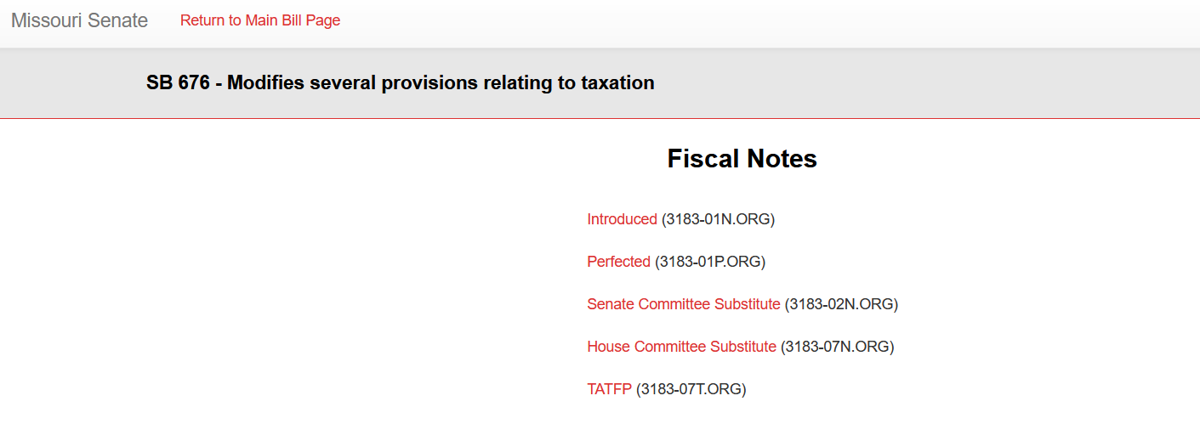

Slide 41
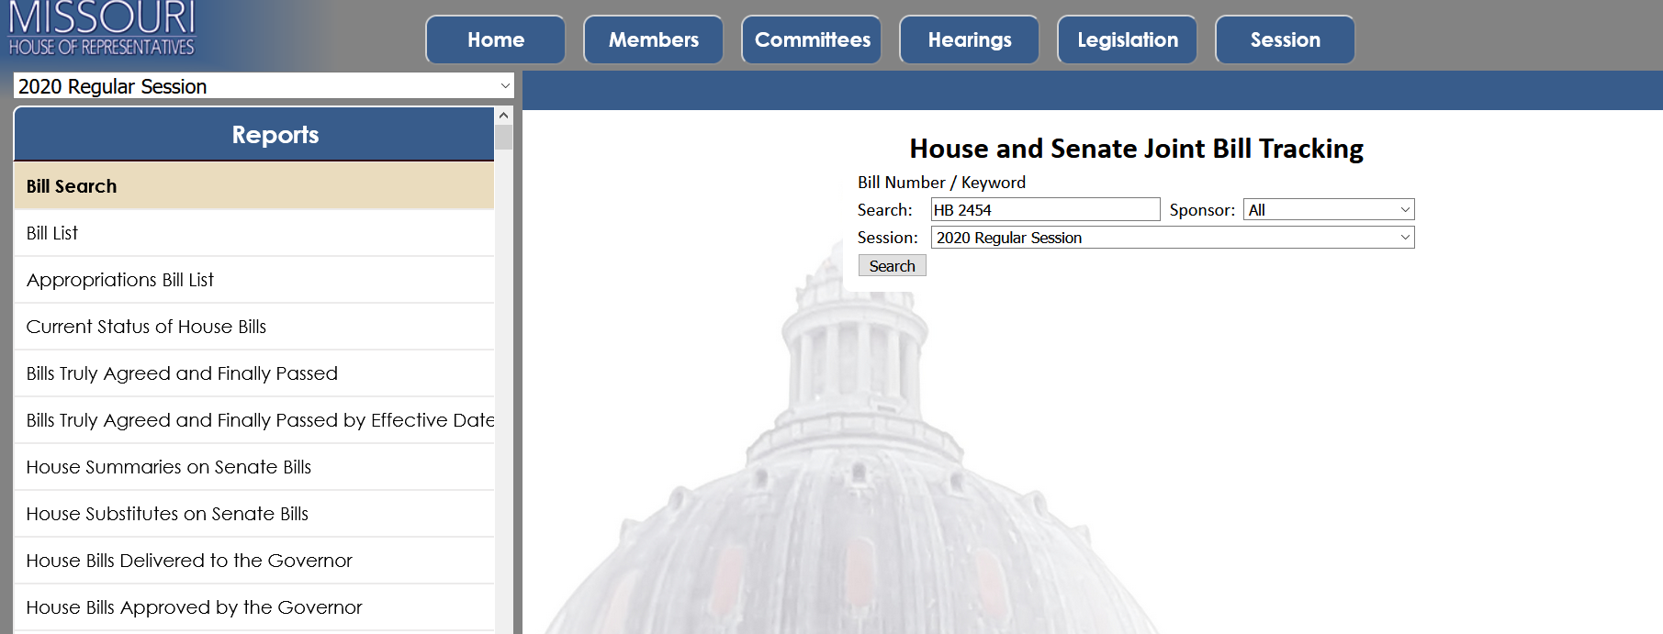

Slide 42
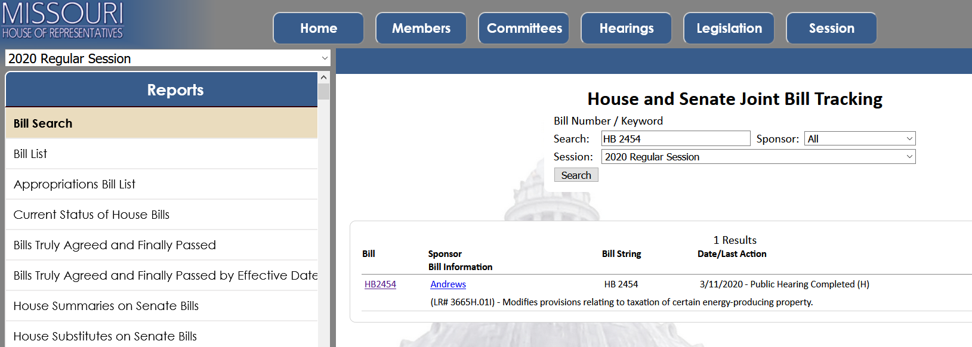
Click Here

Slide 43
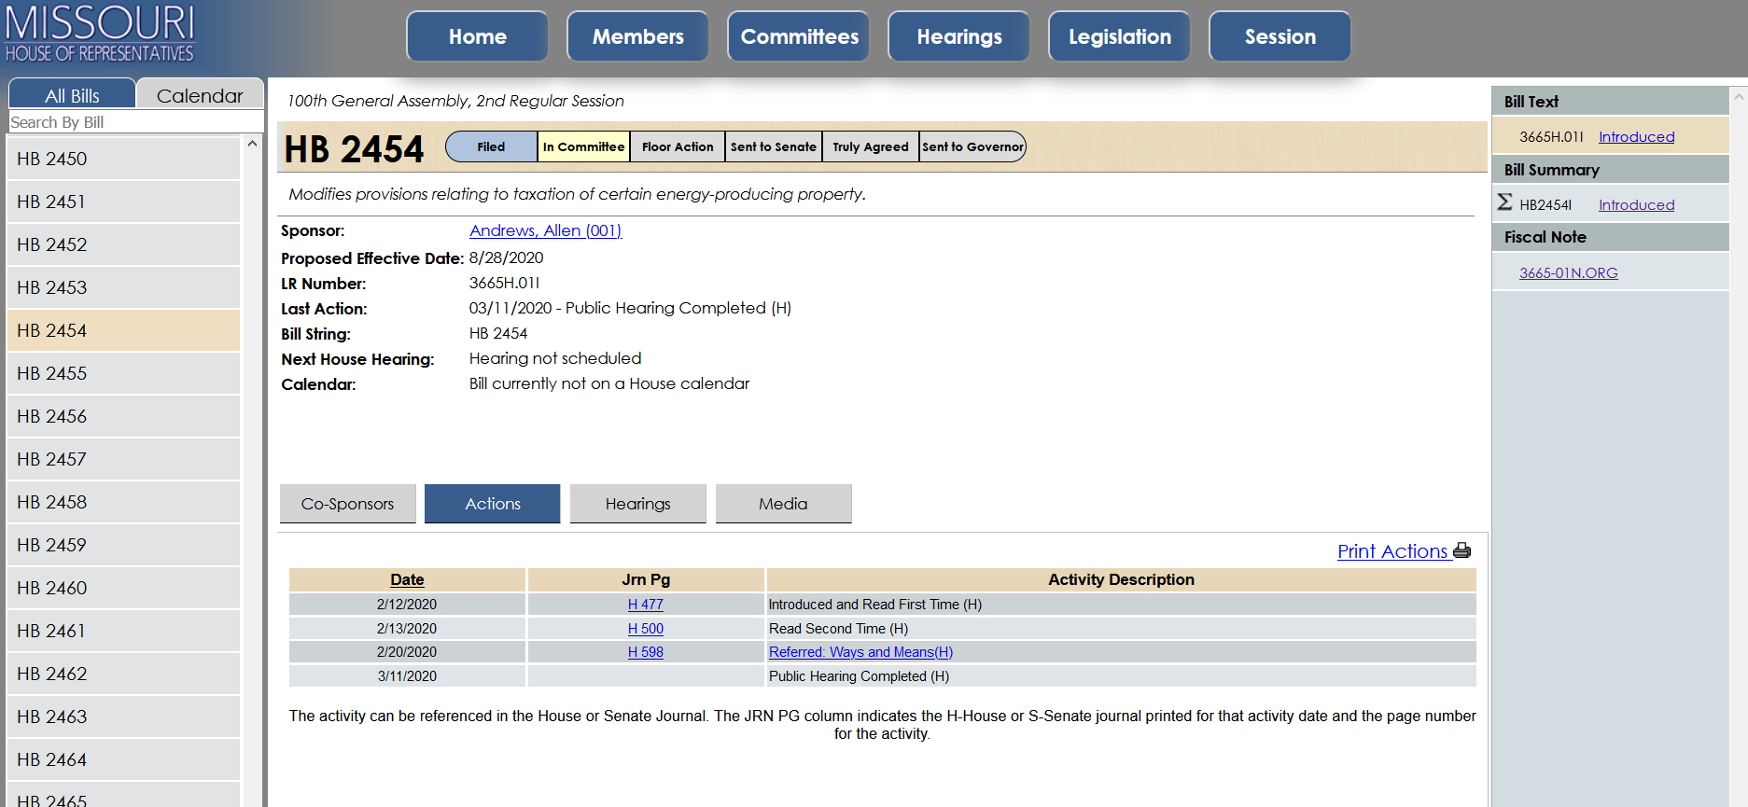

Slide 44
Thank you!
Jessica Harris
Jessica.Harris@lr.mo.gov
573-751-4143

